Slide 1
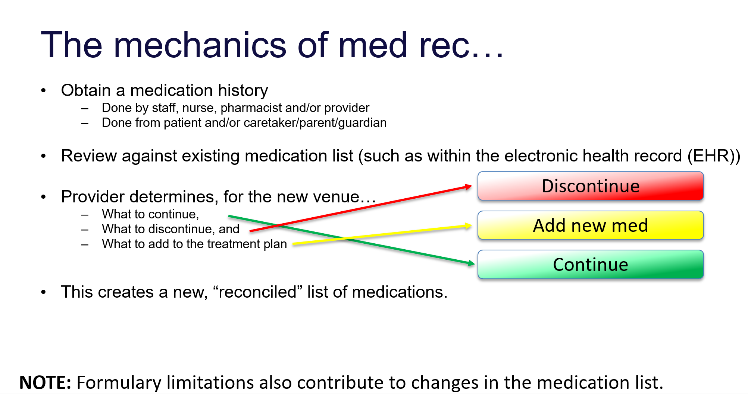

Slide 3
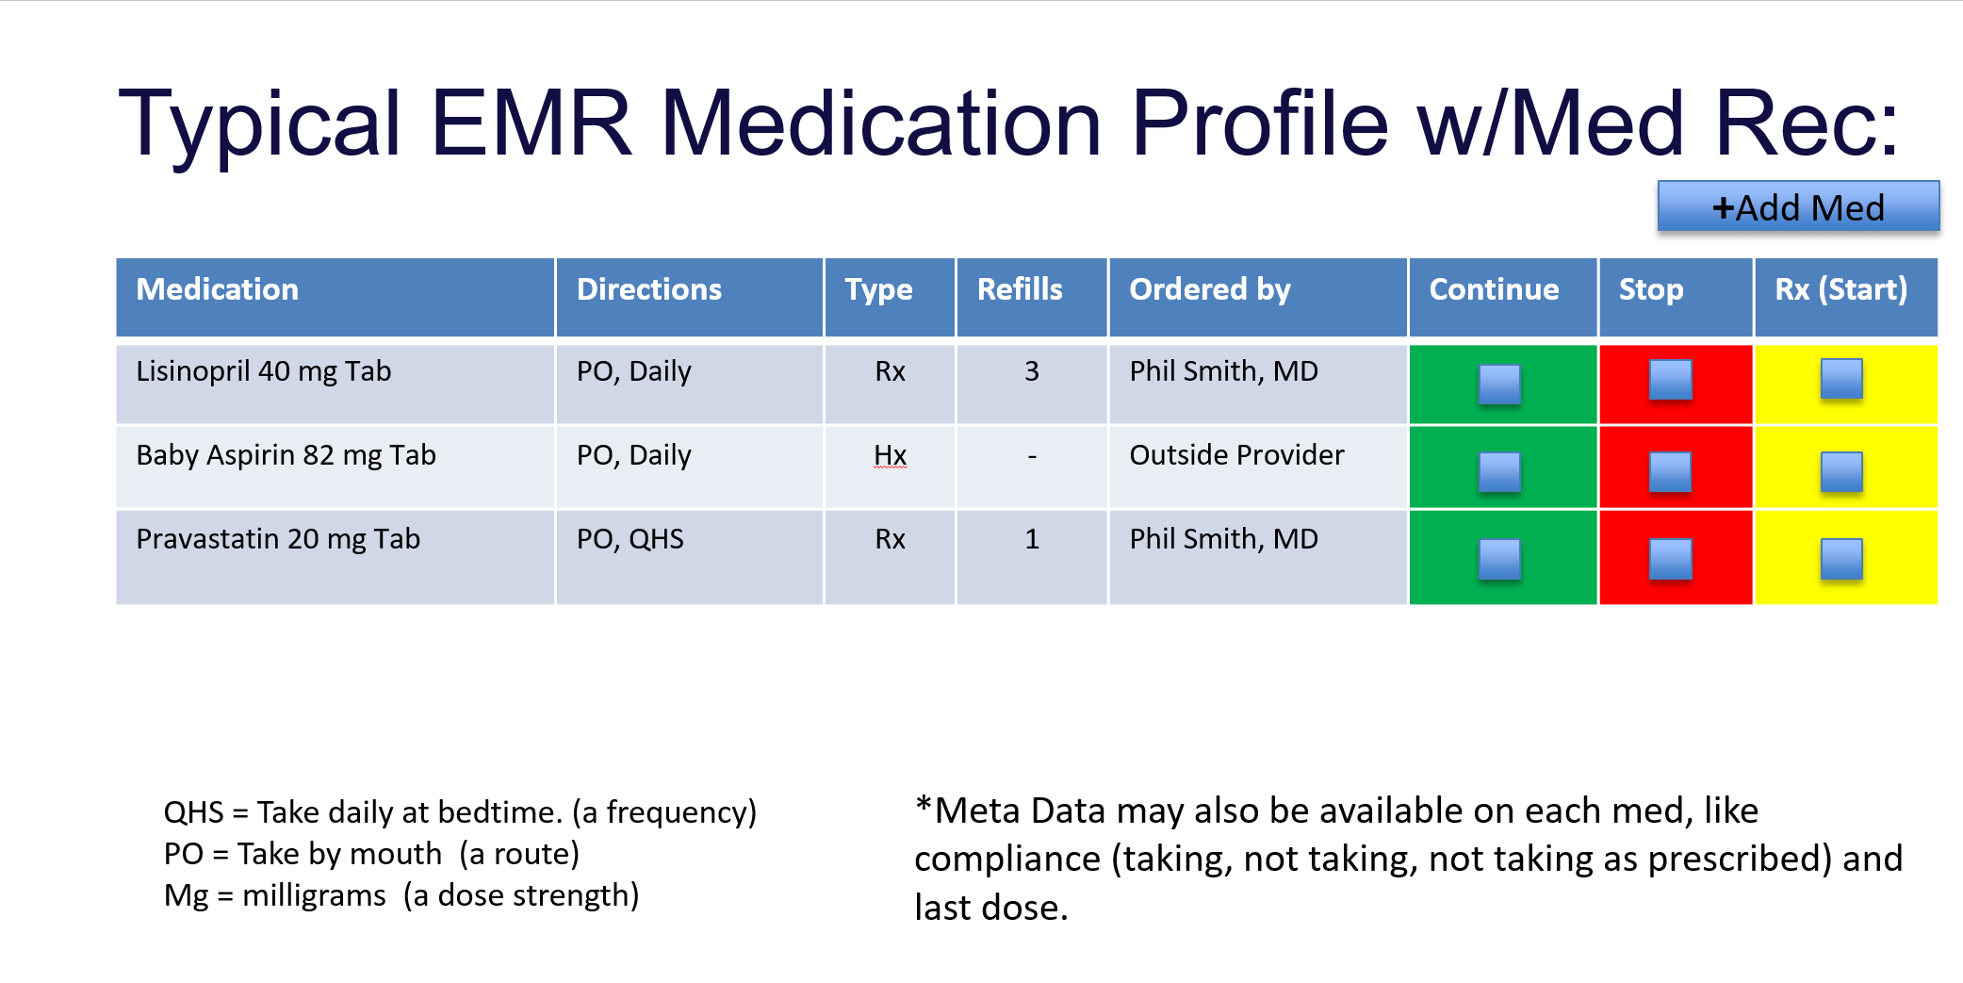

Slide 4
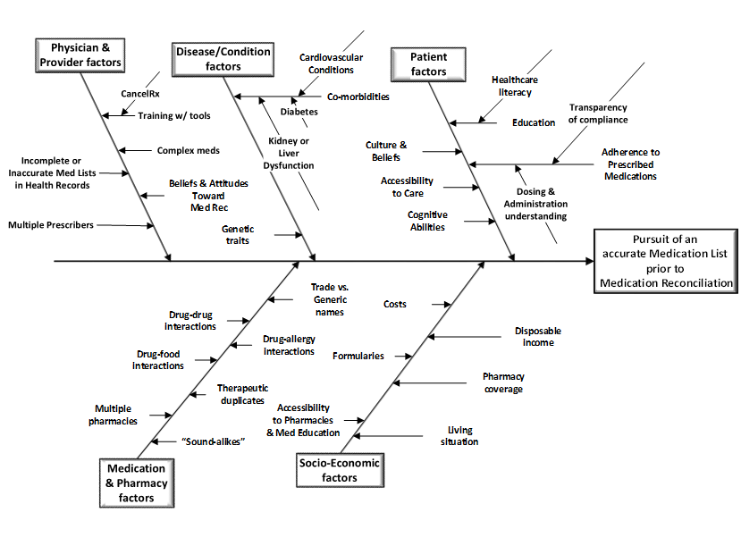

Slide 5
Sources of Current Medications
Patient / Family / Guardian / Parent
Shoebox / Bag of pill bottles
Medication List from patient
Current Physician Electronic Health Record
Old records
Hospital Records including EHR.
Other physician records through HIE
SureScripts eHistory
Contact Pharmacy or other physicians.

